Slide 1
Dissertation, Final Semester
“Time Series Forecasting using MLOPS”
Rishav Saigal
2019AB04045

Slide 2
Index
Problem Statement & Solution
High Level Architecture
Database Schema
Ingestion Work-Flow
Data Processing Work-Flow
Forecasting Work-Flow
Metrics Calculated & Results
Deployment & Scaling
Demo Screens

Slide 3
Problem Statement
Time Series Forecasting has been a fundamental need in various practical domains such as retail, trade-finance, price
prediction and many more. Many solutions have been built but they are still depending upon the old traditional models
and lack of model monitoring KPIs, which might not be useful in future. As we have seen in past few years, the
exponential increase in data volume and frequent changes in data pattern which are affecting the longevity of model
(viz. under-forecasting or over-forecasting). We require more mature solution that can scale up or down according to
the volume of data and generate better models with advance MLOps metrics to provide stable predictions for long run.
Another issue is with the training time of models which has also increased with the increase in data volume.
Solution
To solve this kind of problem we have come up with Time Series Forecasting solution using MLOps in which we will
be focusing specifically in two main components i.e the distributed training of models and scaling along with the long
stability of the models using advance MLOps KPIs. There are lot of techniques that can help us to train our models in
containerized and scaled format. Let’s say we have model 1 and model 2 in which both the models have different
library requirements and computation time. In the above scenario, we can run them in a separate environment from
our local system using docker or kubernetes pods. In our second scenario, we are considering the shifting of pattern in
data over the course of time, our model needs to capture the latest trend; more importantly so to check the model
stability we will be using MLOps monitoring KPIs.

Slide 4
High Level Architecture
Data Ingestion Pipeline
Flat files upload (.csv)
Data Processing Pipeline
Outlier Correction
Imputation
Forecasting Pipeline
Simple Models Forecasting
Blended Models Forecasting
Data Drift metric evaluation
Metrics Evaluation Pipeline
Model Performance metric evaluation
Metrics Evaluation Pipeline
Model Performance metric evaluation
API + Database
Web UI + Visualization

Slide 5
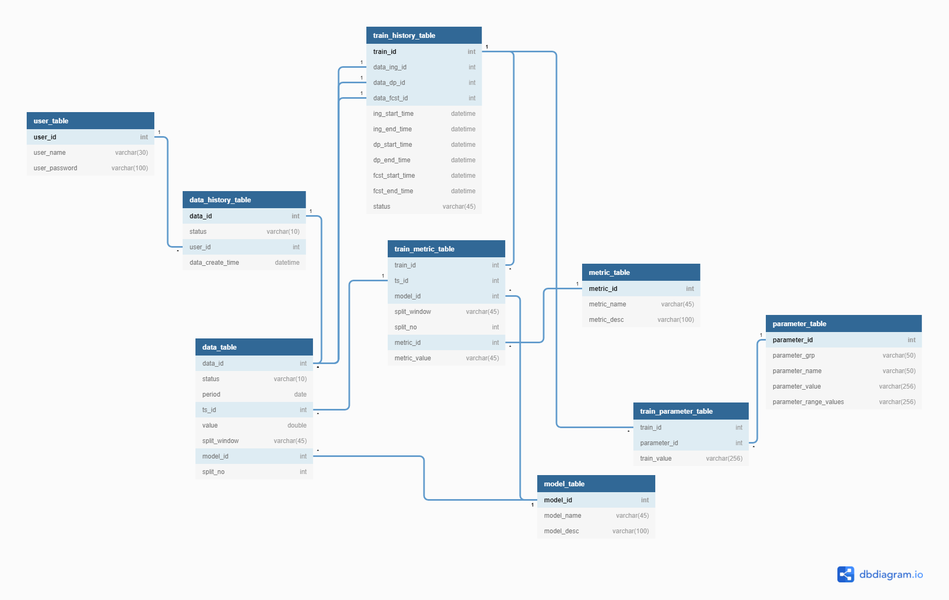
Database Schema

Slide 6
Ingestion Work-Flow
Data Source
Generate Data ID and Train ID.
Data ID it is used for the purpose of storing the time series data in different stages and user reference. Train ID is used for the holding the information of run
Save the results to raw folder. And Insert the Data ID and Train ID to the data_history_table.
Data Source
Generate Data ID and Train ID.
Data ID it is used for the purpose of storing the time series data in different stages and user reference. Train ID is used for the holding the information of run
Save the results to raw folder. And Insert the Data ID and Train ID to the data_history_table.
Flat Files(.csv)
ts_id (time series unique id)
period (time stamp)
value (time series data)
Flat Files(.csv)
ts_id (time series unique id)
period (time stamp)
value (time series data)
Successful
Insert the Train information to the train_history_table.
Insert the data into data_table along with train_id, data_id and data_stage.
If Successful then remove the data from raw to ingested folder and change the state for that data_id to successfull and not the time
Insert the Train information to the train_history_table.
Insert the data into data_table along with train_id, data_id and data_stage.
If Successful then remove the data from raw to ingested folder and change the state for that train id to successfull and not the time
If Failed then remove the data from raw to failed folder and change the state for that train id to failed
If Failed then remove the data from raw to failed folder and change the state for that train id to failed
Failed

Slide 7
Data Processing Work-Flow
Choose create or existing : -
Create means the Train IDs that are in ingestion stage
Exisiting means the Train IDs that are completed runs upto forecasting or data processing
Insert parameters into run_parameter_table
Update the Train ID with new Data ID or use copy existing Train ID and create new Traind with copy of same Data ID
Load Default Data Processing parameters :
impute_choice: linear, mean, median or nearest
impute_if_zero: True or False
outlier_choice: if,lof,zscore
outlier_cnt: auto or any float value
zscore_cutoff: 3
Load the Data from the table with the existing Data ID which is used at the time of ingestion
Triggering Data Processing API:
train_type: create or existing
train_id: any listed train ids under train_type
user_id
parameter: above listed parameters modified or same.
Use the new Data ID for the data processing stage :
Outlier Detection - Each time series wise parallely, it will detect and impute it either will null or with 0 as per user choice
Imputation - Each time series wise parallely, it will impute null values with respective choice of imputation method
Start Data Processing
Save the data

Slide 8
Forecasting Work-Flow
Choose create or existing : -
Create means the Train IDs that are in data processing stage
Exisiting means the Train IDs that are completed runs upto forecasting
Insert parameters into run_parameter_table
Model List:
ARIMA
ETS
Naive
Polynomial Trend
Prophet
Theta
Auto Ensemble
Ensemble
Update the Train ID with new Data ID or use copy existing Train ID and create new Train ID with copy of same Data ID
Load Default Forecasting parameters :
test_size: 0.5
forecast_horizon: 0.1
model_choice: single or multi
model_types: 1,2,3,4,5,6
auto_ensemble: True or False
ensemble: True or False
data_split: expanding, sliding or both
Load the Data from the table with the existing Data ID which is used at the time of data processing
Metric List:
RMSE
RMSPE
AIC
BIC
BIAS
MAPE
PSI
KS
First, we will be splitting the dataset into the format of user specified expanding, sliding or both (as per the test size).
Then we will be passing the train data and predict for next forecast_horizon as per the model selected if auto_ensemble or ensemble is true then we will be passing all the models and generate predictions.
We will also calculate PSI and KS metric to check the verify data drift.
Triggering Forecasting API:
train_type: create or existing
train_id: any listed train ids under train_type
user_id
parameter: above listed parameters modified or same.
Save the results and Forecasting stage completed
Start Forecasting

Slide 9
Metrics Calculated & Results
Pass the Train ID to produce metric for the forecasted results.
Performance Metric :
RMSE - Root Mean Squared Error
RMSPE - Root Mean Squared Percentage Error
BIAS
MAPE - Mean Absolute Percentage Error
Model Metric :
AIC - Akaike's Information Criteria
BIC - Bayesian Information Criteria
With Respect to :
Train ID
Time Series ID
Model ID
Window Type - Expanding or Sliding
Window No. - no of window splits
Metric

Slide 10
PSI Results - (Data Drift)

Slide 11
MAPE Results - (Performance Metric)

Slide 12








Deployment & Scaling
Docker Cluster
Containers
Web App
Data Processing Module
Worker 1
Worker 2
Worker 1
Task Monitoring UI
Forecasting Module
Worker 2
Backend API
Database
Performance Reports

Slide 13
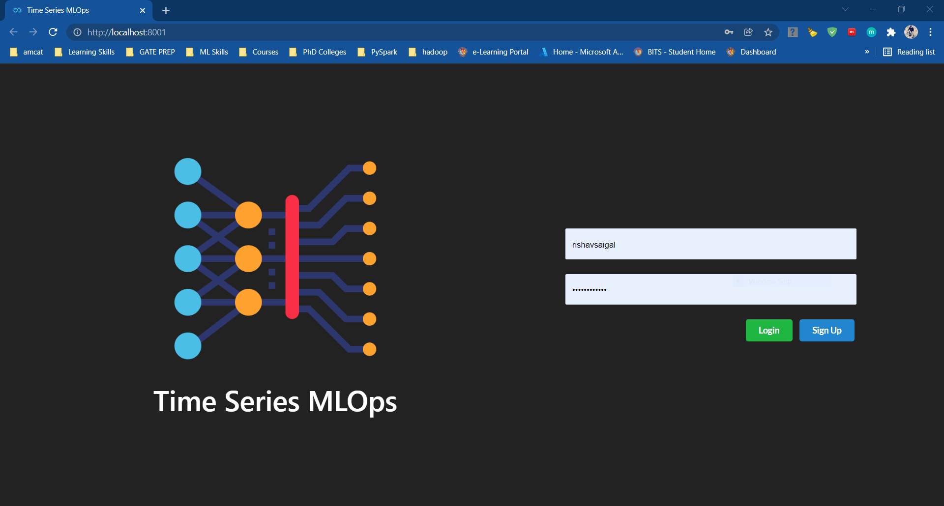
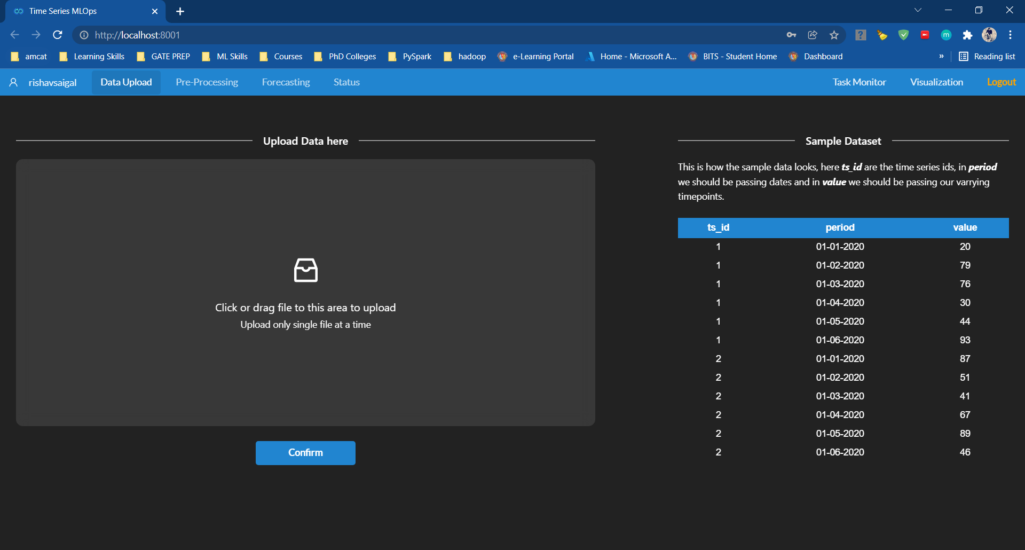
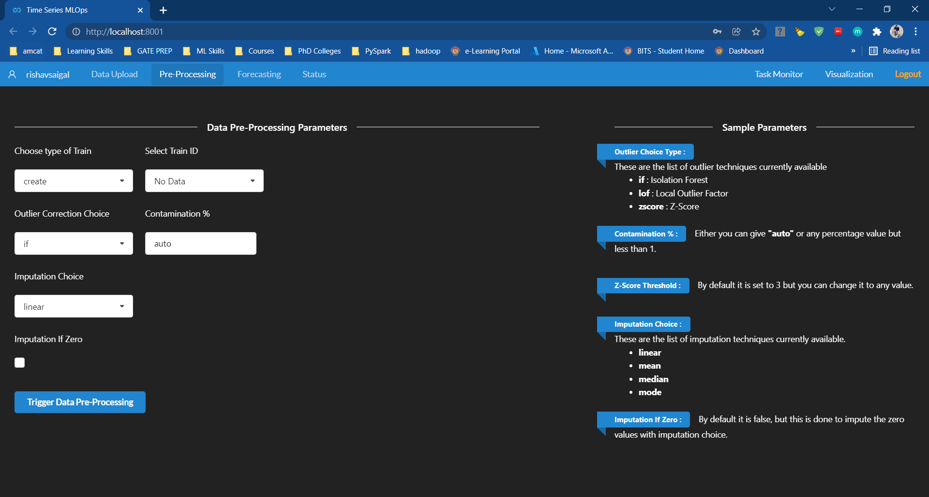
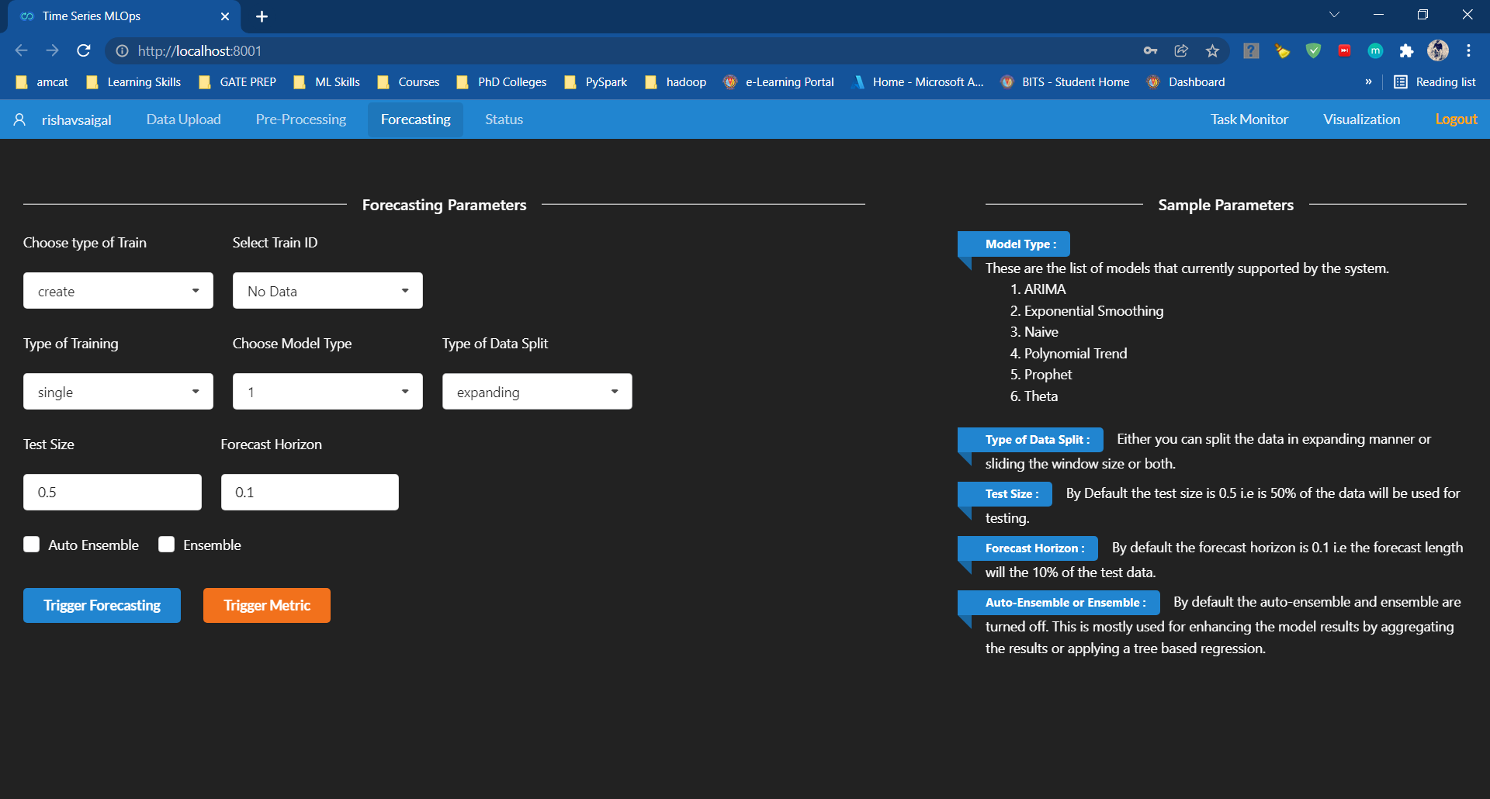
Demo Screens

Slide 14
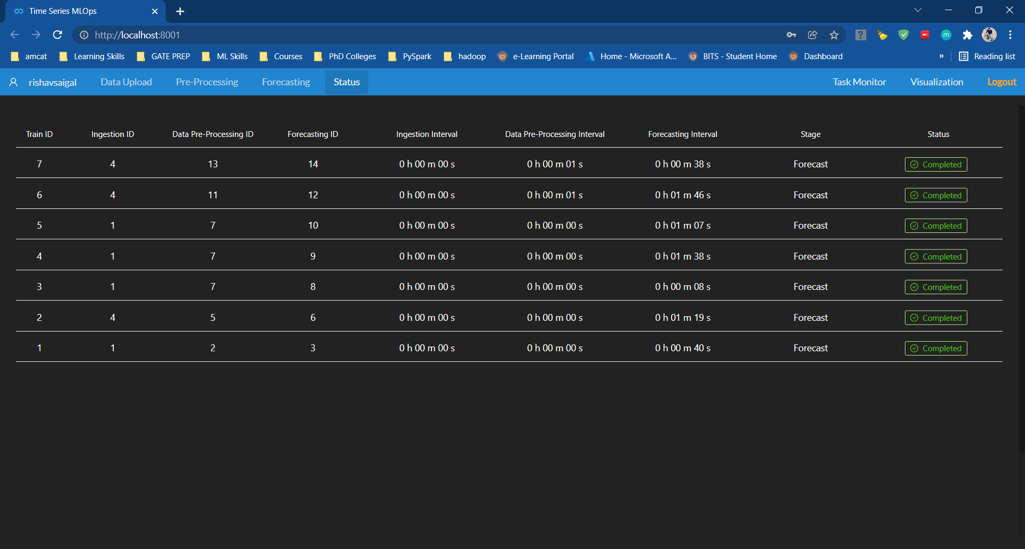
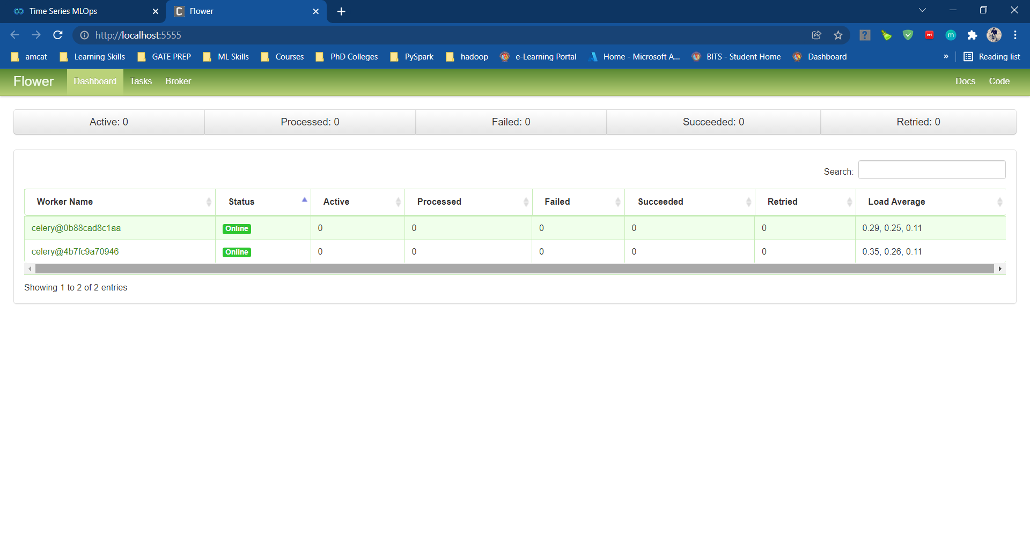
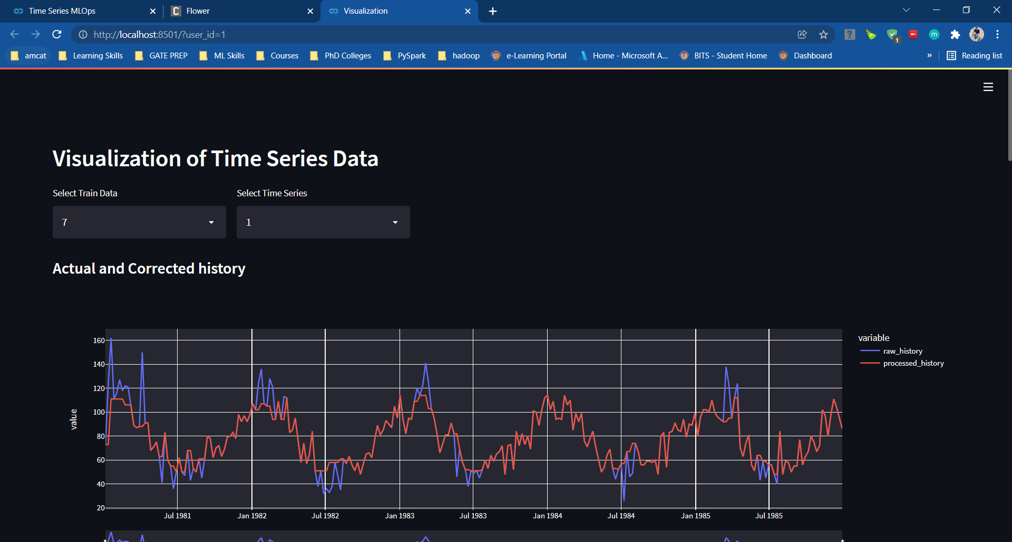
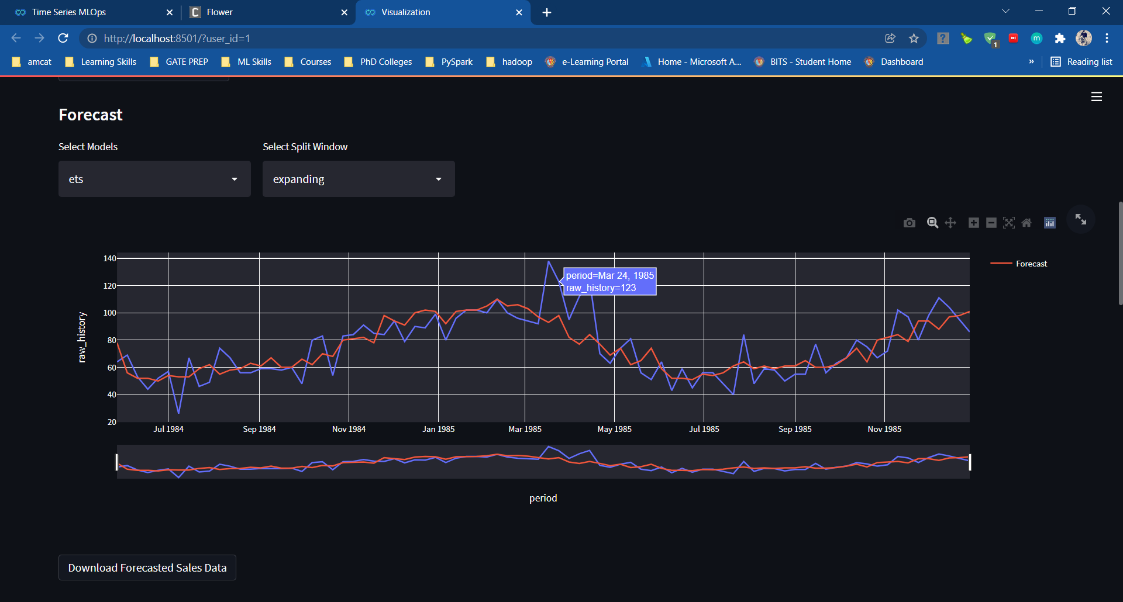
Demo Screens

Slide 15
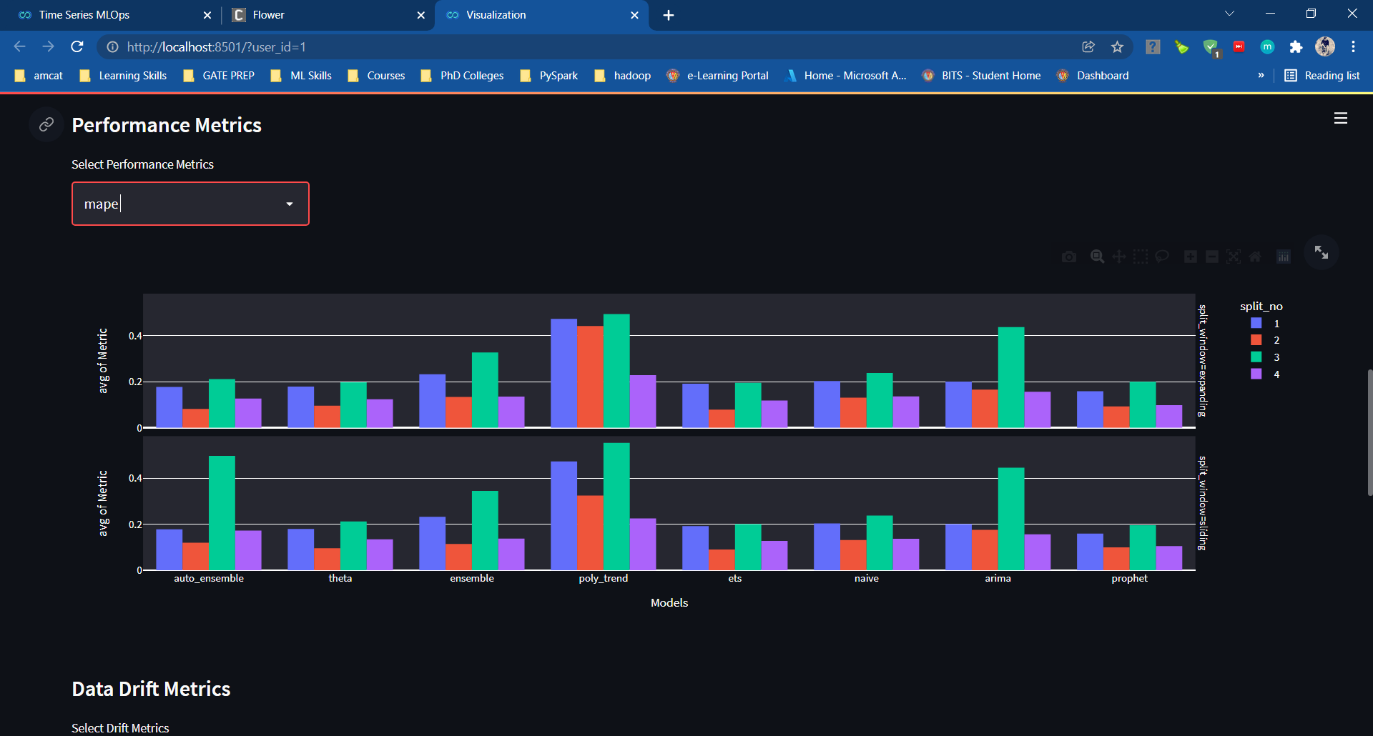
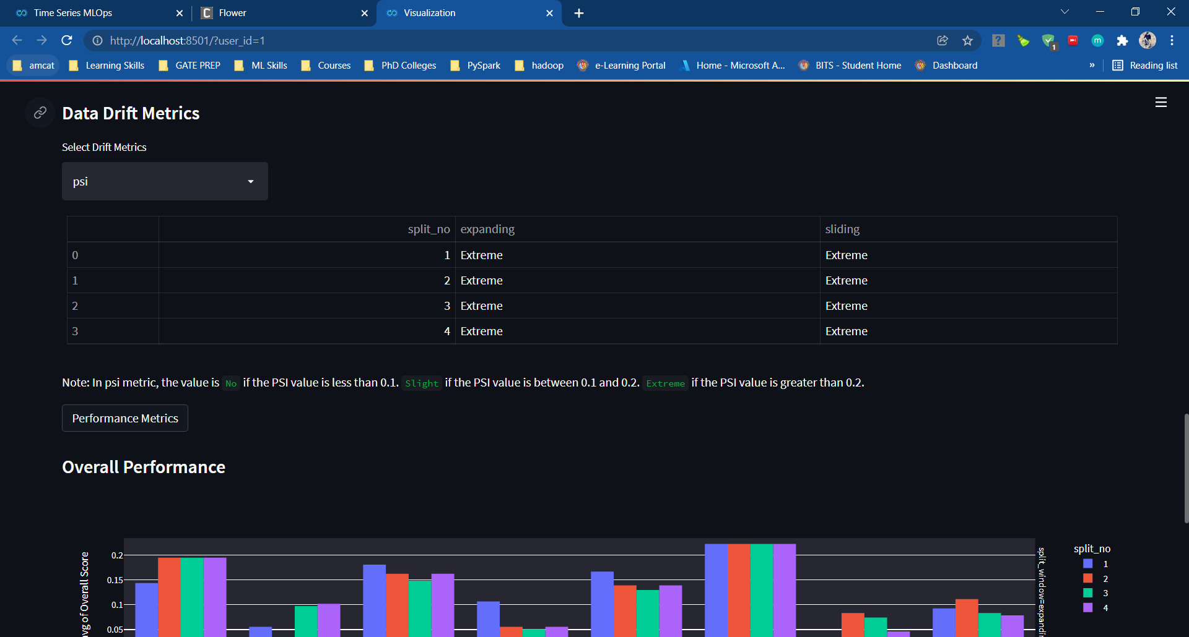
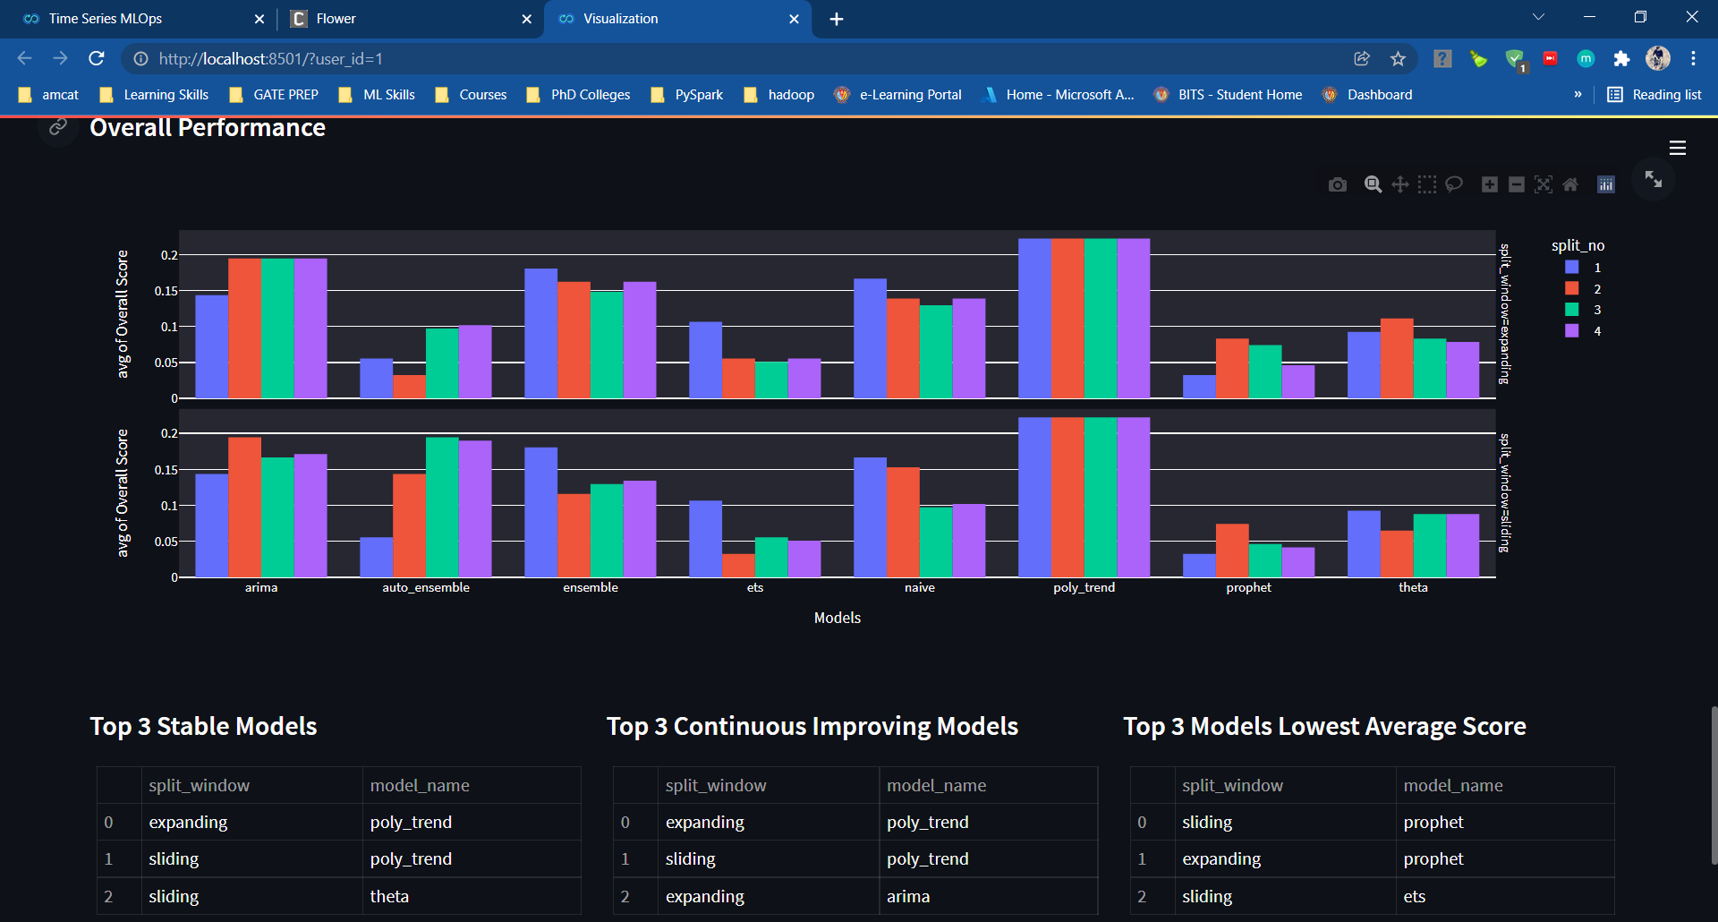
Demo Screens

Slide 16
Thank You

